Slide 1
Statistical Hypothesis Generation and Testing
Mr. Shrikrishna Anand Narvekar
Assitant Professor
Computer Engineering department
Agnel Institute of Technology and Design

Slide 2
Hypothesis
It involves making an educated guess (hypothesis) about a population parameter and then testing this hypothesis using sample data.
Hypothesis Testing is a fundamental procedure in inferential statistics used to make decisions about population parameters based on sample data.

Slide 3
Real-Life Example in Industry: Quality Control in Manufacturing
Scenario:
A company manufactures light bulbs, and the quality control department wants to ensure that the average lifespan of their light bulbs is 1000 hours.
Step 1: Formulate the Hypothesis
Null Hypothesis (H₀): The average lifespan of the light bulbs is 1000 hours. (H₀: μ = 1000)
Alternative Hypothesis (H₁): The average lifespan of the light bulbs is not 1000 hours. (H₁: μ ≠ 1000)
Notes:
Here, the null hypothesis represents the claim that the company's bulbs meet the quality standard. The alternative hypothesis represents the possibility that the bulbs do not meet this standard.

Slide 4
Step 2: Collect Sample Data
The quality control team selects a random sample of 100 light bulbs and measures their lifespans.
Step 3: Perform Hypothesis Testing
Using the sample data, the team calculates the sample mean and conducts a hypothesis test (e.g., a t-test or z-test). The test will provide a p-value, which indicates the probability of observing the sample data if the null hypothesis is true.
Step 4: Make a Decision
If the p-value is low (typically below 0.05), the team rejects the null hypothesis, concluding that the average lifespan of the bulbs is not 1000 hours.
If the p-value is high, they fail to reject the null hypothesis, meaning there isn't enough evidence to say the bulbs' lifespan is different from 1000 hours.

Slide 5
Step 5: Take Action
If the null hypothesis is rejected, the company may need to investigate potential issues in the manufacturing process and make necessary adjustments.
If the null hypothesis is not rejected, the company continues production, confident that their product meets the quality standard.
Conclusion:
This process helps the company maintain product quality and ensures that the manufacturing process remains consistent. Hypothesis testing in this context allows the company to make informed decisions based on statistical evidence, minimizing the risk of producing substandard products.

Slide 6
Hypothesis Testing
Hypothesis
Null Hypothesis
Alternate Hypothesis
Hypothesis Testing
Statistical Test
Non Parametric Test
Chi-Square Test, U-Test, H-Test
Parametric Test
Z-Test,T-test, F-Test, Annova

Slide 7
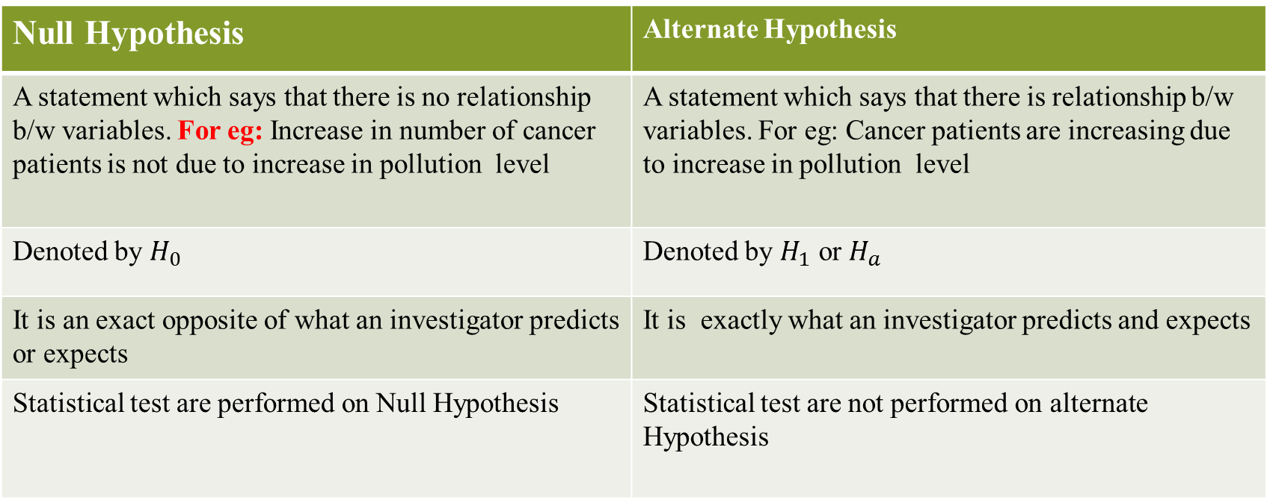
Educated Guess About the population
Hypothesis
Predication of the relationship b/w two or more variables
Null Hypothesis | Alternate Hypothesis
A statement which says that there is no relationship b/w variables. For eg: Increase in number of cancer patients is not due to increase in pollution level | A statement which says that there is relationship b/w variables. For eg: Cancer patients are increasing due to increase in pollution level
Denoted by $H_{0}$ | Denoted by $H_{1}$ or $H_{a}$
It is an exact opposite of what an investigator predicts or expects | It is exactly what an investigator predicts and expects
Statistical test are performed on Null Hypothesis | Statistical test are not performed on alternate Hypothesis
NULL Hypothesis are either rejected or not rejected

Slide 8
Statistical Test
Statistical Test are conducted to test the hypothesis and find inferences about the population.
For that, samples are selected & various tests are performed on them to find inference about population under study.
There are two types of test: Parametric Test and non-parametric Test

Slide 9
Parametric Tests
Parametric tests are applied under the circumstances where the population is normally distributed or assumed to be normally distributed.
Parameters like mean, standard deviations are used.
For example: T-test, F-test, Z-test, ANOVA, Pearson’s Coefficient correlation.
There are applied where data is quantitative.
Scale of measurement is either interval or ratio level.

Slide 10
Non parametric tests
Non parametric tests are applied under the circumstances where the population is not normally distributed(skewed distribution).
Wherever parametric tests cannot be applied, them non-parametric .
Parameters like mean standard deviations are not used.
For example: Chi-square test, U-test, H-test.
Applied when data is qualitative
Scale of measurement is either ordinal or nominal.

Slide 11
Parametric vs Non-parametric
Parametric test | Non-parametric test
Assumes distribution to be Normal | Does not assume distribution to be normal
Make assumption about population | Does not make any assumptions about the population
Parameters such as mean, standard deviations are used | No such parameters are used
Scale of measurement is either interval or ratio | Scale of measurement is either Ordinal or nominal
Mean as central tendency | Median as central tendency
Examples : T-test, Z-Test, ANNOVA | Examples: Chi-Square test, U-Test , H-test

Slide 12
Testing techniques
T-Test
Chi-Square test
ANNOVA
We will learn how to solve numerical on each of the topic mentioned above

Slide 13
Briefly, describe the importance parametric tests used in context of testing of hypothesis. How such tests are different from non-parametric tests? Explain. 8 marks
Parametric tests are statistical methods that rely on assumptions about the distribution of the data. These tests are widely used for hypothesis testing due to their efficiency and ability to provide robust results when the assumptions are met.
Key Points of Importance:
Power of the test: Parametric tests are more powerful, meaning they are more likely to detect a true effect or difference when one exists.
Efficiency: They make full use of the data by leveraging specific distributional properties, which leads to more accurate conclusions.
Wide Applicability: Commonly used in fields like medicine, social sciences, and engineering to validate hypotheses.
Precision: Provide exact p-values and confidence intervals, offering precise estimates of effects.
Notes:
Importance of Parametric Tests with Real-World Link
Power of the Test
Explanation: Parametric tests (like the t-test) have more statistical power when assumptions are met.
Real-World: If patients’ blood pressure readings (interval data) are normally distributed, using a t-test can quickly detect whether the new medicine is actually more effective. A non-parametric test might miss this effect due to lower power.
Efficiency
Explanation: Parametric tests use all the information in the data, including mean and variance.
Real-World: When testing two groups of patients (new drug vs. old drug), a parametric test like ANOVA considers both the average blood pressure reduction and the variability. This leads to clearer and faster conclusions for the medical board.
Wide Applicability
Explanation: They are widely used in many domains such as medicine, engineering, and social sciences.
Real-World: In medicine, parametric tests validate drug trials. In engineering, an ANOVA test can compare the durability of different machine parts. In social sciences, a Z-test can check whether a sample survey reflects the general population.
Precision
Explanation: Parametric tests provide exact p-values and confidence intervals, not just a general sense of difference.
Real-World: In the drug trial, the test may show that the new medicine lowers blood pressure by 5 mmHg on average, with a 95% confidence interval of 4–6 mmHg. This level of precision is crucial for regulatory approval and doctor recommendations.

Slide 14
Write a short note on statistical hypothesis generation and testing? Jan 2023 7 marks
Statistical Hypothesis Generation and Testing is a critical process in inferential statistics used to make decisions or draw conclusions about a population based on sample data.
Hypothesis Generation
Hypothesis generation involves creating assumptions or educated guesses about a population parameter.
Types of Hypothesis
Null Hypothesis: A statement that assumes no effect, no difference, or no relationship in the population.
Alternate Hypothesis: A statement that contradicts the null hypothesis.
Example: In testing a new drug, the null hypothesis might state that the drug has no effect on patients, while the alternative hypothesis would state that the drug does have an effect.

Slide 15
Hypothesis Testing: Hypothesis testing is a formal statistical procedure used to decide whether to reject or fail to reject the null hypothesis based on sample data.
Steps in Hypothesis Testing:
Select a significance level (α): This is the threshold for determining whether the observed data is sufficiently unlikely under the null hypothesis. Common values are 0.05 or 0.01.
Collect Sample Data: Gather data through experiments, surveys, or other methods.
Choose a Test Statistic: Depending on the data and hypotheses, select a test statistic (e.g., t-test, z-test, chi-square test) to compare the sample data to what is expected under the null hypothesis.
Calculate the Test Statistic and P-Value: Use the sample data to compute the test statistic and determine the p-value, which indicates the probability of observing the data if the null hypothesis is true.

Slide 16
Make a decision
    Reject H₀: If the p-value is less than α, reject the null hypothesis in favor of the alternative hypothesis.
    Fail to Reject H₀: If the p-value is greater than or equal to α, there is not enough evidence to reject the null hypothesis.
    Example: If testing whether a new teaching method improves student performance, and the p-value is found to be 0.03 with α = 0.05, the null hypothesis that the method has no effect would be rejected.
Conclusion: Statistical hypothesis generation and testing provide a structured approach to making data-driven decisions. By systematically evaluating hypotheses, researchers can draw valid conclusions about the population from which the sample was drawn, ensuring that their findings are supported by evidence rather than mere speculation

Slide 17
T-Test
It is a parametric test of hypothesis testing based on Student’s T distribution.
It is essentially, testing the significance of difference of the mean values when sample size is small(i.e. less than 30) & when population standard deviation is not available.
Assumptions:
Population distribution is normal
Samples are random and independent
Sample size is small
Population standard deviation is not known

Slide 18
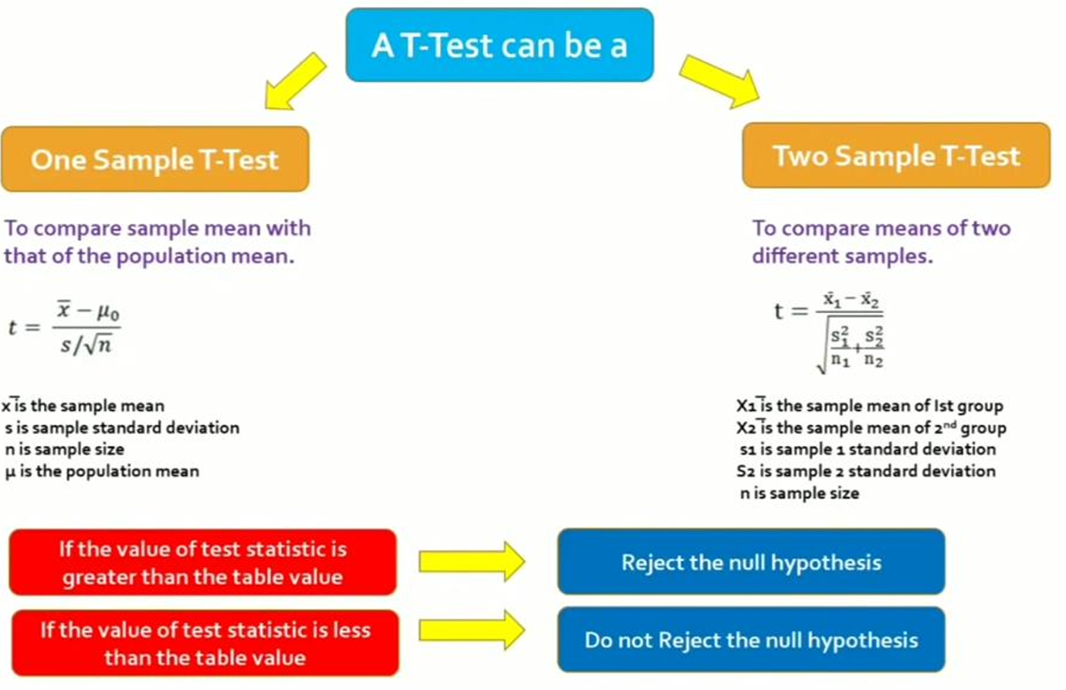

Slide 19
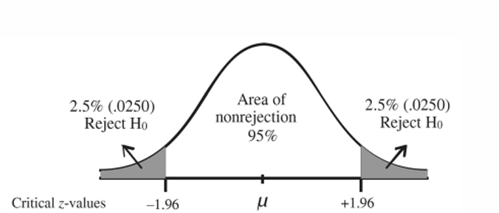
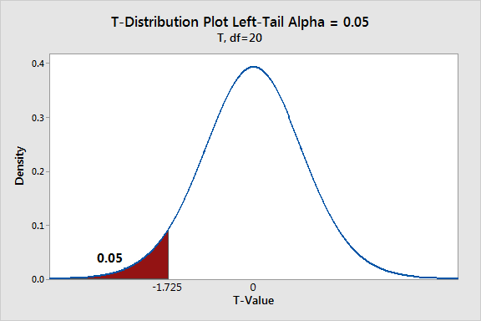
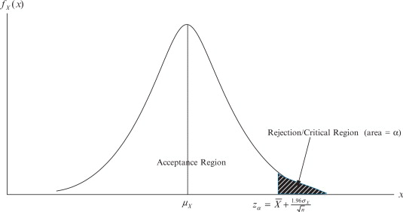
Two tailed and one tailed test

Slide 20
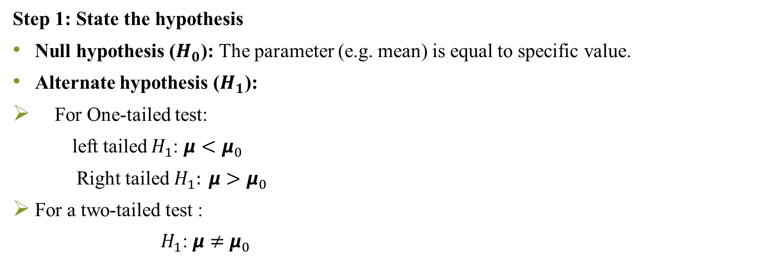
Steps for T-test
Step 1: State the hypothesis
Null hypothesis ($H_{0}$): The parameter (e.g. mean) is equal to specific value.
Alternate hypothesis ($H_{1}$):
For One-tailed test:
left tailed $H_{1}$: $μ<μ_{0}$
Right tailed $H_{1}: μ>μ_{0}$
For a two-tailed test :
$H_{1}$: $μ$ $≠$ $μ_{0}$

Slide 21
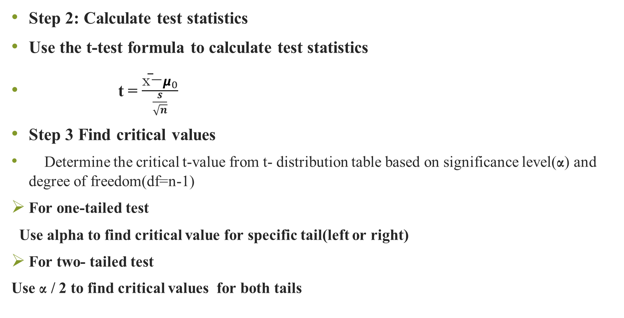
Step 2: Calculate test statistics
Use the t-test formula to calculate test statistics
t = $\frac{\text{x}\text{̄}\text{−}μ_{0}}{\frac{s}{\sqrt{n}}}$
Step 3 Find critical values
Determine the critical t-value from t- distribution table based on significance level(α) and degree of freedom(df=n-1)
For one-tailed test
Use alpha to find critical value for specific tail(left or right)
For two- tailed test
Use α / 2 to find critical values for both tails

Slide 22
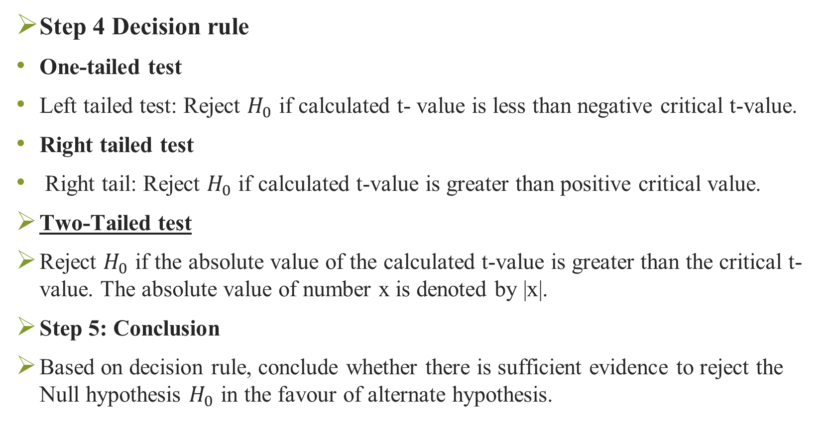
Step 4 Decision rule
One-tailed test
Left tailed test: Reject $H_{0}$ if calculated t- value is less than negative critical t-value.
Right tailed test
Right tail: Reject $H_{0}$ if calculated t-value is greater than positive critical value.
Two-Tailed test
Reject $H_{0}$ if the absolute value of the calculated t-value is greater than the critical t-value. The absolute value of number x is denoted by |x|.
Step 5: Conclusion
Based on decision rule, conclude whether there is sufficient evidence to reject the Null hypothesis $H_{0}$ in the favour of alternate hypothesis.

Slide 23
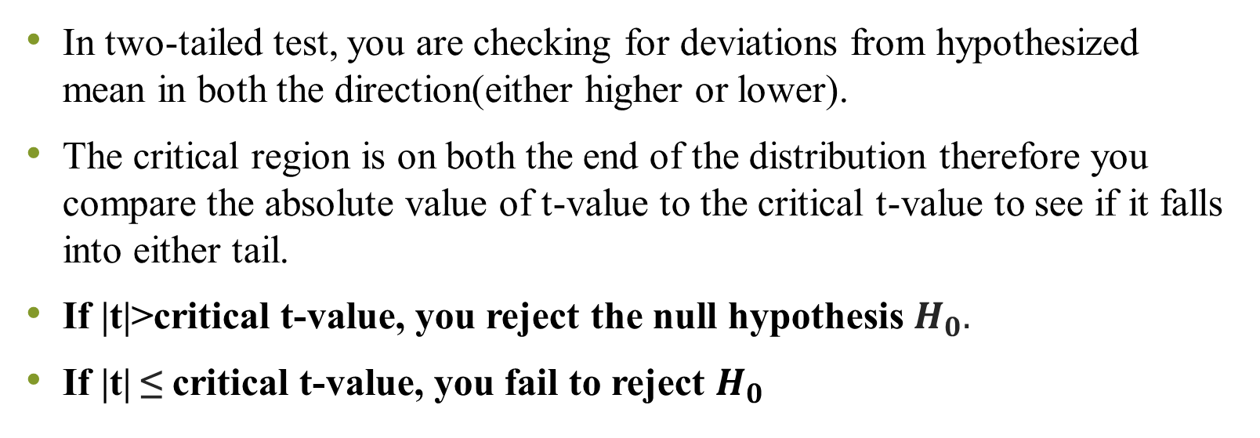
Why absolute value is used in two tailed test?
In two-tailed test, you are checking for deviations from hypothesized mean in both the direction(either higher or lower).
The critical region is on both the end of the distribution therefore you compare the absolute value of t-value to the critical t-value to see if it falls into either tail.
If |t|>critical t-value, you reject the null hypothesis $H_{0}.$
If |t| ≤ critical t-value, you fail to reject $H_{0}$

Slide 24
What is critical value?
Critical value is the cut off value that is compared with the test value to take decision about the null hypothesis.
It divides the graph into two sections; rejection area and acceptance area.
If test value falls into rejection area, then reject the null hypothesis.
It is derived from the level of significance of the test

Slide 25
How to calculate t-critical value
Step 1: Select the row for the type of t-test(one-tail of two tailed)
Step 2: Select the column for significance level.
Step 3: Select the row for degrees of freedom.
Obtained value at the intersection of point of all three steps is your t-critical value

Slide 26
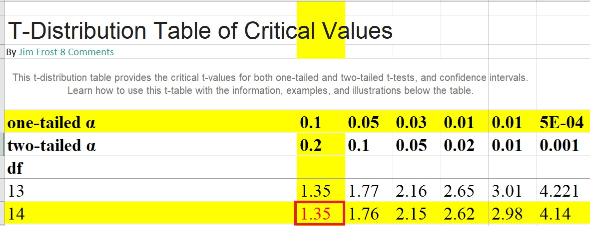
Case I
n= 15, confidence interval=90%, Left tailed
Significance level =1- confidence interval
=1-0.90
=0.10
Degrees of freedom= n-1
15-1

Slide 27
Case II
n=25, confidence interval=95%, right tailed
Significance level=1- confidence level
=1-0.95
=0.05
Degrees of freedom= n-1
=25-1
=24

Slide 28
Case III
n=35, confidence interval=99%, Two tailed
Find t- critical value

Slide 29
Question
Q. 1 A company manufactures car batteries with an average life span of 2 or more years. An engineer believes this value to be less. Using 10 samples, he measures average life span to be 1.8 years with standard deviation of 0.15.
State the null and alternate hypothesis
At a 99% confidence level, is there enough evidence to discard the null hypothesis

Slide 30
Question
Q.2 A factory has machine that dispenses 80 ml of a fluid in a bottle. An employee believes that average amount of fluid is not 80ml. Using 40 samples he measures average amount dispensed by machine to be 78ml with standard deviation of 2.5.
State null hypothesis and alternate hypothesis
At a 95% confidence level, is there enough evidence to support a idea that machine is not working properly?

Slide 31
Question (June 2023 and 2025)
Internal Test marks of student are as follows:
10.5,9,7,12,8.5,6.5,8,11,9.9
Mean population score is 12 and standard deviation is 1.80. Is the mean value for student significantly different from the mean population value? Let alpha value is 0.05 so corresponding t-value is 2.62 7 marks

Slide 32
Question (June 2023 and 2025)
A sample size of 16 people is taken. Suppose a claim is made that the average number of days a person spends a vacation is more than equal to 5 days based on sample of 16 people whose mean came out to be 9 days. Sample standard deviation is found to be 3 days at a level of significance of 0.05 and t-value for right tailed test comes out to be 1.753. Calculate the value of t and check the null hypothesis 6 marks

Slide 33
Question (June 2023)
The weights of 8 individuals were recorded before and after participating in a fitness program. Is there any significant difference between their weights before and after the program? Analyze. Use α=0.05 and t-value=2.36 7 marks
Before | 180 | 200 | 230 | 240 | 170 | 190 | 200 | 165
After | 140 | 145 | 150 | 155 | 120 | 130 | 140 | 130

Slide 34
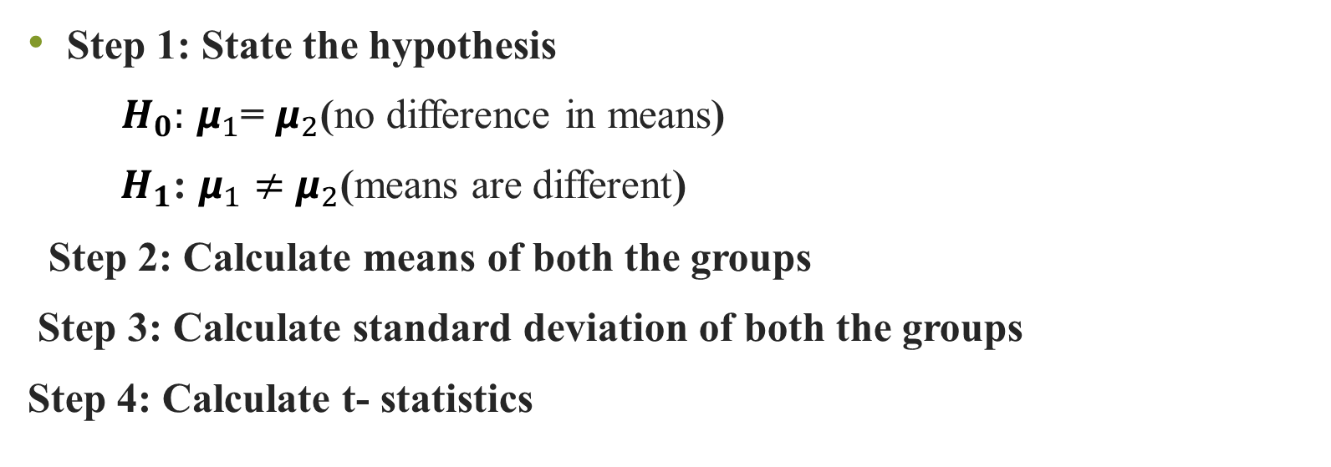
Steps for two sample T-test
Step 1: State the hypothesis
$H_{0}:$ $μ_{1}$= $μ_{2}$(no difference in means)
${ H}_{1}$: $μ_{1}≠$ $μ_{2}$(means are different)
Step 2: Calculate means of both the groups
Step 3: Calculate standard deviation of both the groups
Step 4: Calculate t- statistics

Slide 35
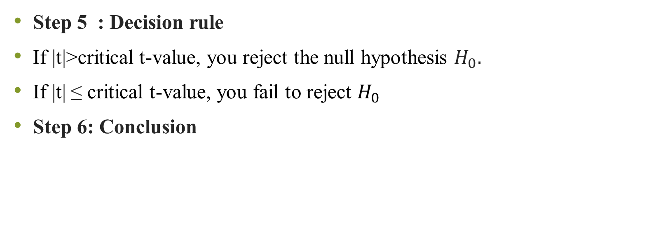
Steps for two sample T-test
Step 5 : Decision rule
If |t|>critical t-value, you reject the null hypothesis $H_{0}.$
If |t| ≤ critical t-value, you fail to reject $H_{0}$
Step 6: Conclusion

Slide 36
Question (June 2023 and 2025)
The subject marks of boys and girls are as follows:
Is there any significant difference between the marks of girls and boys? Assume alpha=0.05, t-value(critical)=2.11
Boys | 12 | 14 | 10 | 8 | 16 | 5 | 3 | 9 | 11
Girls | 21 | 18 | 14 | 20 | 11 | 19 | 8 | 12 | 13 | 15

Slide 37
What is p-value?
It is the probability of getting the value of our test statistics if null hypothesis is true.
The lower the p-value, the stronger is the evidence that null hypothesis is false.
Since p-value is a probability value it will always lie between 0 to 1.
A high p-value indicates the observed results are likely to occur by chance under the null hypothesis & that’s why in this case, null hypothesis would not be rejected.
On the other hand, low p-value indicates that results are less likely to occur by chance under the null hypothesis & hence in this case null hypothesis would be rejected.

Slide 38
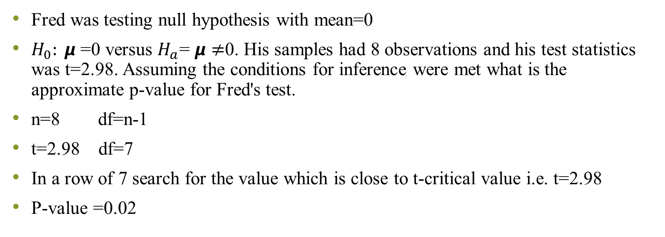
How to find P-value from t-test statistics
Fred was testing null hypothesis with mean=0
$H_{0}: μ$ =0 versus $H_{a}$= $μ≠$0. His samples had 8 observations and his test statistics was t=2.98. Assuming the conditions for inference were met what is the approximate p-value for Fred's test.
n=8 df=n-1
t=2.98 df=7
In a row of 7 search for the value which is close to t-critical value i.e. t=2.98
P-value =0.02

Slide 39
Question
Q.3 The average weight of all residents in town XYZ is 168lbs. The nutritionist believes the true mean to be different. She measured the weight of 36 individuals and found the mean to be 169.5lbs with standard deviation of 3.9.
State null hypothesis and alternate hypothesis
At 95% confidence interval, is there enough evidence to discard null hypothesis( Use P- value method)

Slide 40
Z-test
It is parametric test for hypothesis testing
It is used to determine whether the means are different when the population variance is known & sample size is large (i.e. greater than 30).
It assumes:
Population distribution is normal and
Samples are random and independent
Sample size is large
Population standard deviation is known

Slide 41
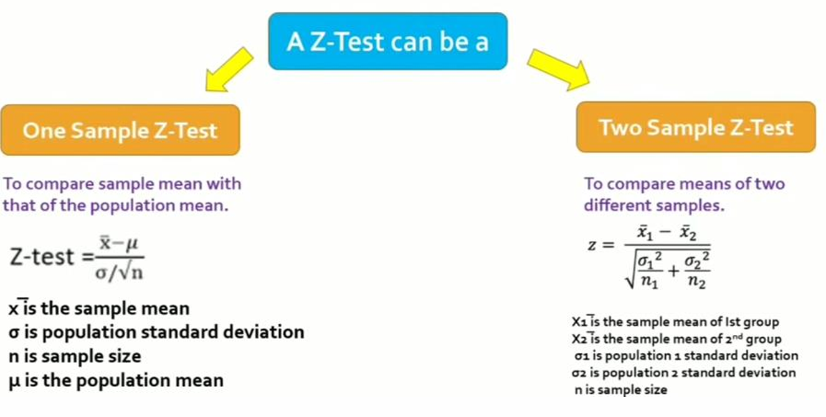

Slide 42
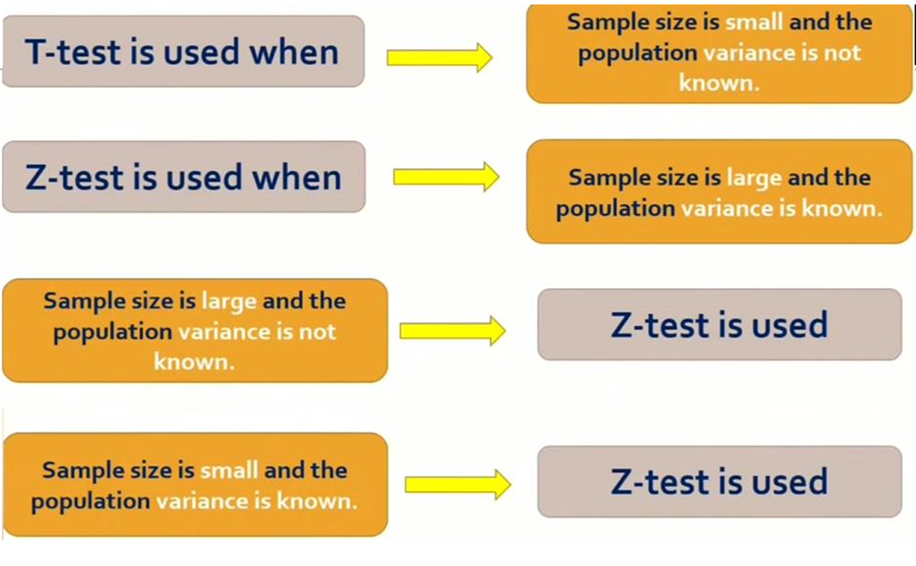

Slide 43
Question (2023)
On an examination given to students at a large number of different schools, the mean grade was 74.5 and standard deviation 8.0. At one particular school, where 200 students took examination, the mean grade was 75.9. Discuss the significance of result at the 0.05 from the view point of 6 marks
One tailed test
Two tailed test

Slide 44
How to calculate P-value for given z=2.47 for standard normal distribution
Steps to Find the p-value:
Locate the z-value:
  In the z-table, find the row that corresponds to the first two digits of the z-value (in this case, 2.4).
  Then, find the column that corresponds to the second decimal place of the z-value (in this case, 0.07).
Interpret the cumulative probability:
  Since the table shows the cumulative probability from the left up to the z-value, the value you find will be the p-value for a one-tailed test.

Slide 45
Example z= 2.47
Locate 2.4 in the row.
Locate 0.07 in the column.
At the intersection of row 2.4 and column 0.07, you’ll find a value of approximately 0.9932.
Calculate the p-value:
  The p-value for a one-tailed test is 1- 0.9932=0.0068

Slide 46
ANOVA
It is called as Analysis of variance, It is parametric test of hypothesis testing
It was developed by Ronald Fisher, also referred to as fisher’s ANOVA.
It is extension of T-test and Z-test.
It is used to Test significance of difference of mean values among more than two sample groups.
It used F-test to statistically test the equality of means & relative variance between them

Slide 47
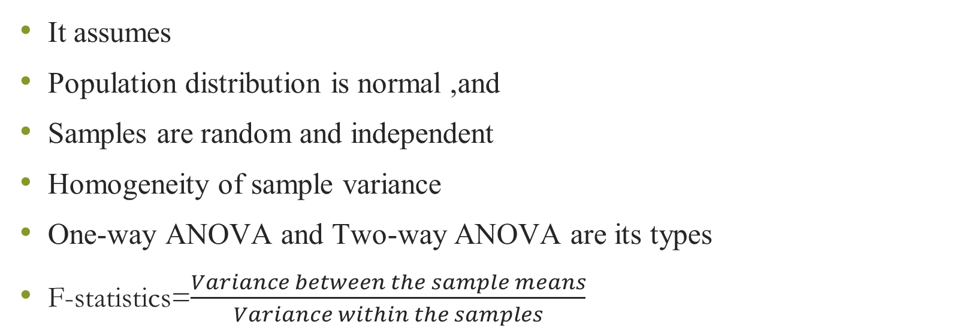
ANOVA
It assumes
Population distribution is normal ,and
Samples are random and independent
Homogeneity of sample variance
One-way ANOVA and Two-way ANOVA are its types
F-statistics=$\frac{Variance between the sample means}{Variance within the samples}$

Slide 48
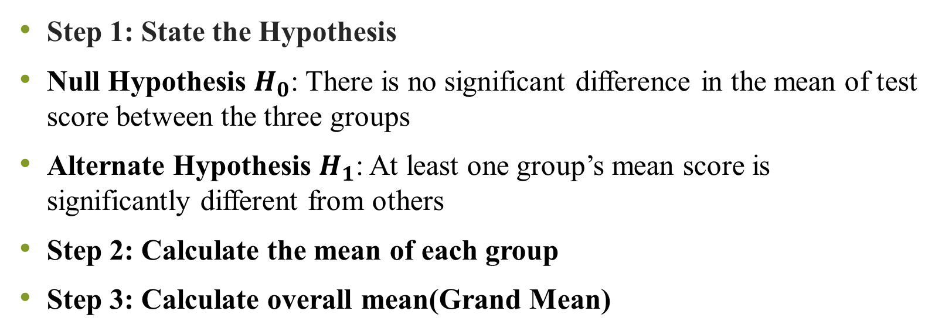
Steps for ANOVA
Step 1: State the Hypothesis
Null Hypothesis $H_{0}$: There is no significant difference in the mean of test score between the three groups
Alternate Hypothesis $H_{1}$: At least one group’s mean score is significantly different from others
Step 2: Calculate the mean of each group
Step 3: Calculate overall mean(Grand Mean)

Slide 49


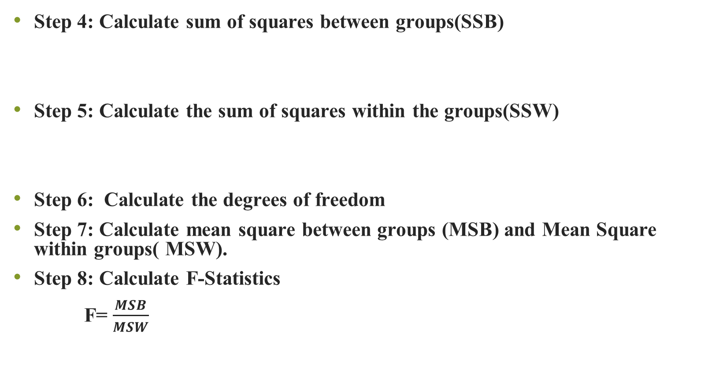
Step 4: Calculate sum of squares between groups(SSB)
Step 5: Calculate the sum of squares within the groups(SSW)
Step 6: Calculate the degrees of freedom
Step 7: Calculate mean square between groups (MSB) and Mean Square within groups( MSW).
Step 8: Calculate F-Statistics
F= $\frac{MSB}{MSW}$

Slide 50
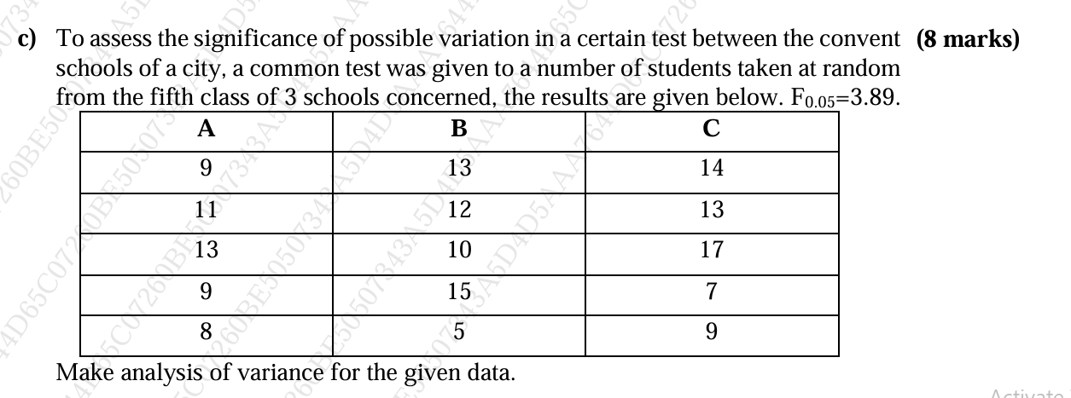
Question June 2023

Slide 51
A Chief Marketing Officer (CMO) of a company marketing carbonated soft drinks has developed three new flavors of cola and wishes to measure customer preference for these flavors. A total of 12 customers participated in the study, with each flavor tested by 4 customers. Customer preference was recorded on a 9-point Likert scale (1 = least favored, 9 = most favored).
The collected data are as follows:
The objective is to determine whether there is a statistically significant difference in mean customer preference among the three cola flavors using One-Way ANOVA.
The test will be conducted at a 5% level of significance (α = 0.05).
The F-critical value = 4.26 (df = 2, 9).
Customer Group | Flavor-A | Flavor-B | Flavor-C
1 | 4 | 6 | 8
2 | 2 | 4 | 6
3 | 4 | 5 | 8
4 | 2 | 5 | 6

Slide 52
Chi-Square test
It is non-parametric test of hypothesis testing
It is used as test of goodness of fit and test of independence of variable.
It helps in assessing the goodness of fit between a set of observed values & those expected values.
It makes comparison between expected frequencies and observed frequencies
Greater the difference greater is the value of Chi-square

Slide 53
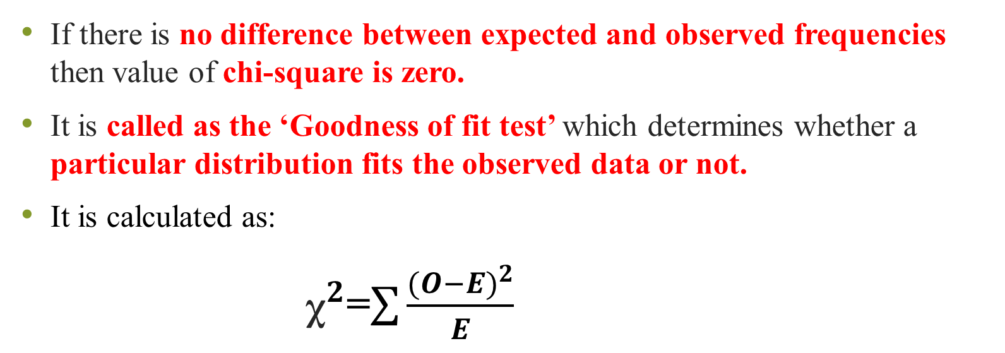
If there is no difference between expected and observed frequencies then value of chi-square is zero.
It is called as the ‘Goodness of fit test’ which determines whether a particular distribution fits the observed data or not.
It is calculated as:
${\text{χ}}^{2}$=$\sum{\frac{({O−E)}^{2}}{E}}$

Slide 54
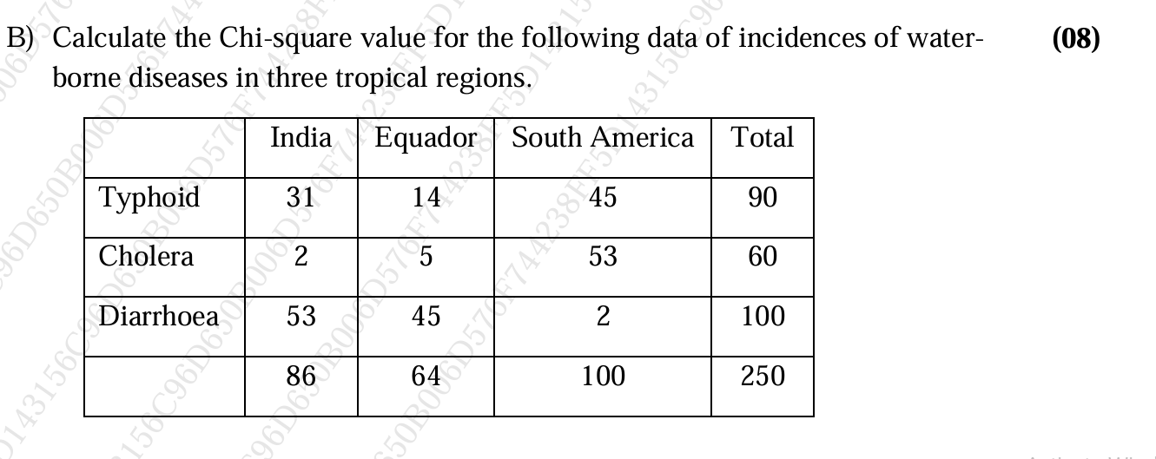
Question (Dec 2023)

Slide 55
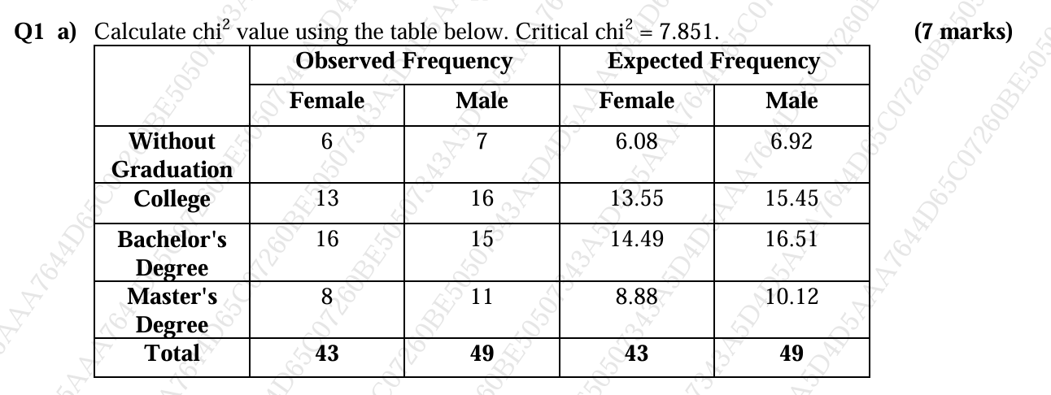
Question(June 2023)

